Slide 1
CUSTOMER RETENTION PROJECT
Submitted By:
Megha Singh
Submitted To:
Flip Robo Technologies

Slide 2
Introduction
Customer retention is necessary nowdays, if the customer is satisfied, it helps the company to distinguish itself among its competitors and thus helps to grow and develop more.
Using this Case study we can actually predict from e-commerce where Retailors business will work more. Using EDA we can find allot of ways where a Retailors should invest more and grow there business.
Using EDA we will also be looking at the expectations of the customer on the goods which customers like to by from e-commerce website.

Slide 3
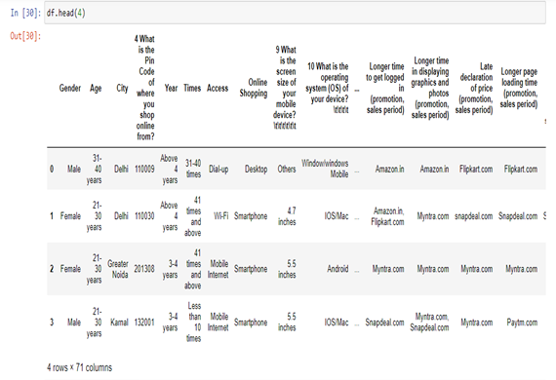

DATA SOURCES
Using df.head we can see the top 5 rows of the datasets.
Here I have used “df.head(4)”.To see the starting 4 table values.
Using “df.shape”, we can find how many rows and columns are present.
Here in our dataset, we have 269 rows and 71 column.

Slide 4
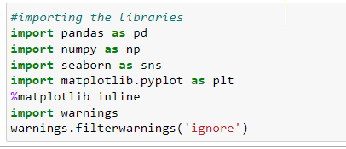
Libraries
1.Here we are using ML libraries for EDA .
2.Using seaborn and matplotlib we can visualize the dateset and can predict what is the graph of the datasets.
3.We can analyze what is growing in the market and can give our prediction as a Data Scientist.

Slide 5
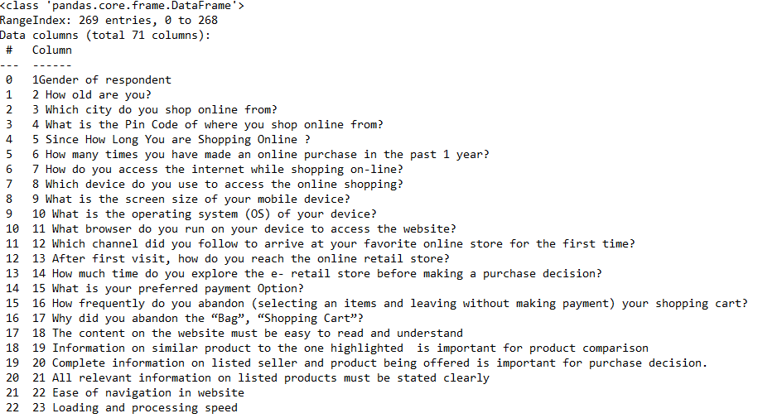
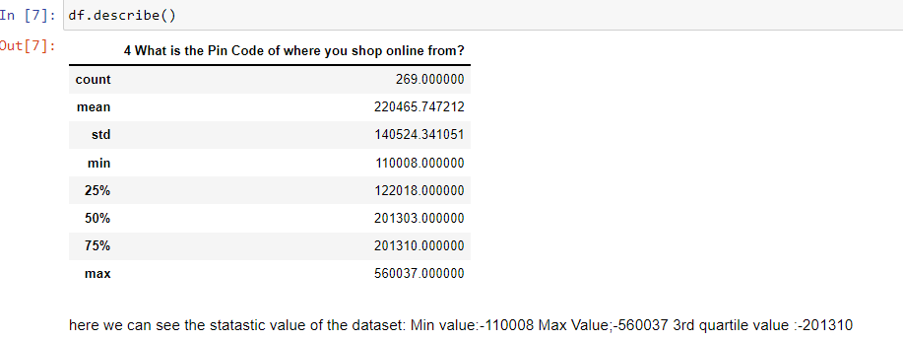
Statistical Summary
df.info()
df.describe()

Slide 6
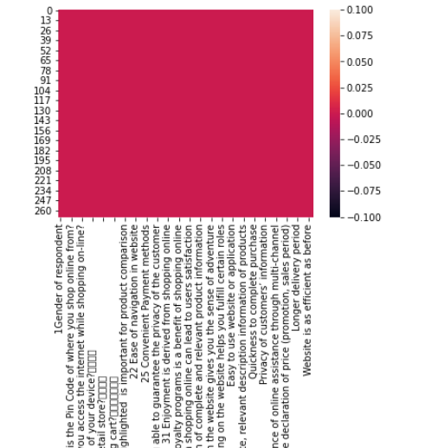
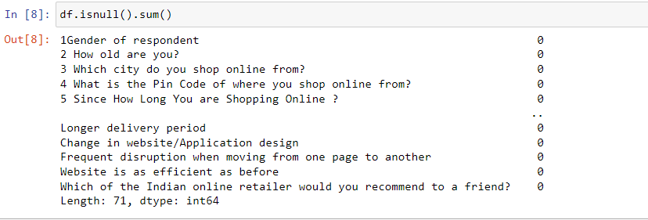
Handling Null Values
The null values are checked using isnull().sum() function and then filtering the missing count columns only which results in getting no features having null values in actual.
sns.heatmap(df.isnull())

Slide 7
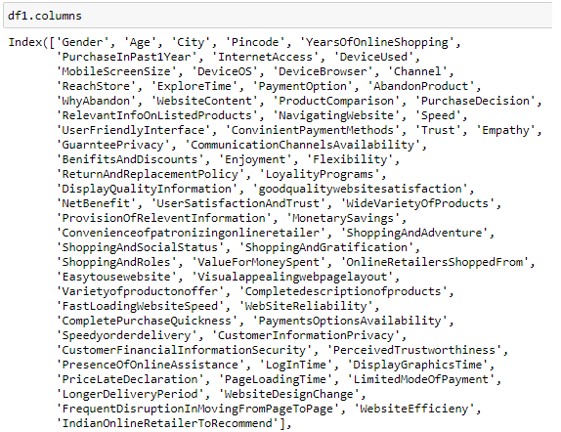
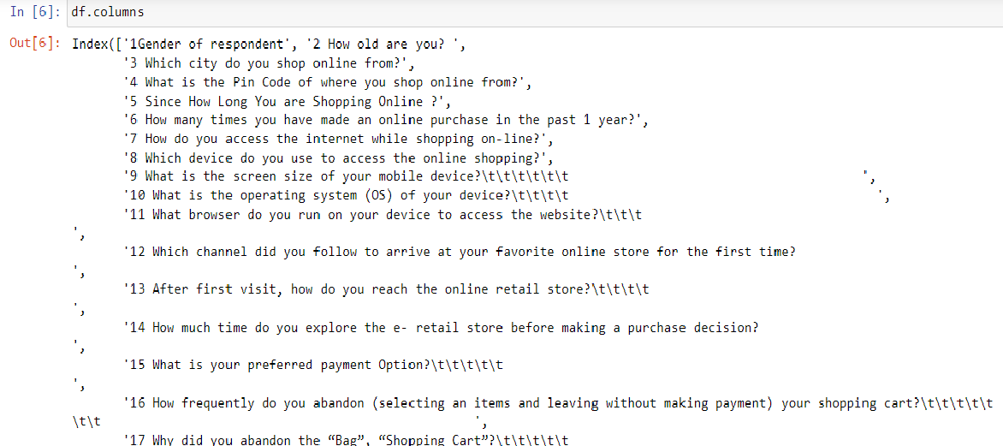
DATA PREPROCESSING

Slide 8
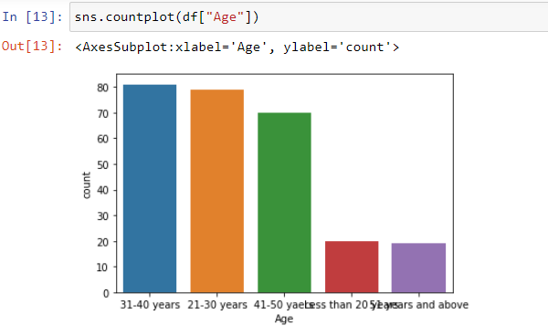
DATA VISUALIZATION

Slide 9
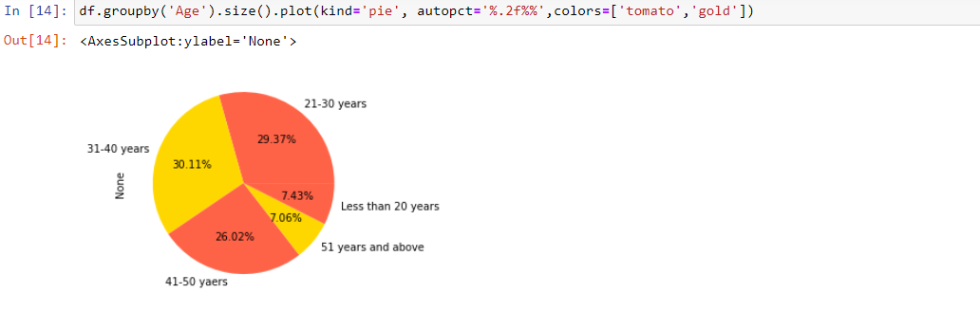
DATA VISUALIZATION

Slide 10
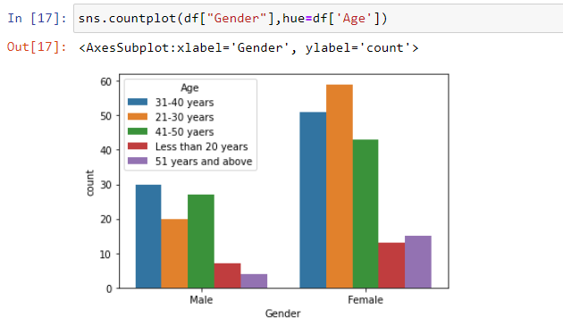
DATA VISUALIZATION

Slide 11
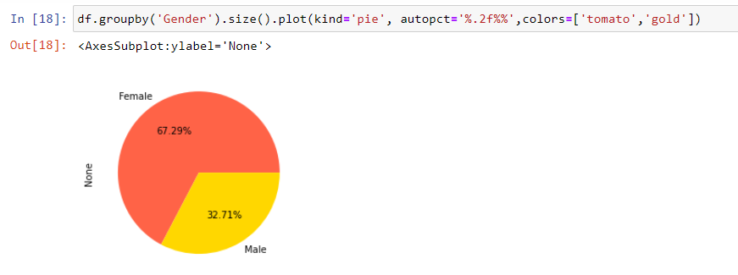
DATA VISUALIZATION

Slide 12

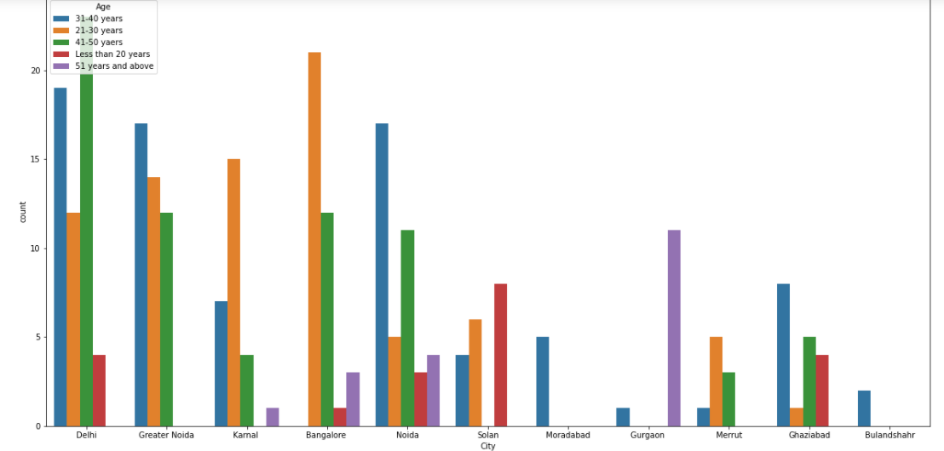
DATA VISUALIZATION

Slide 13
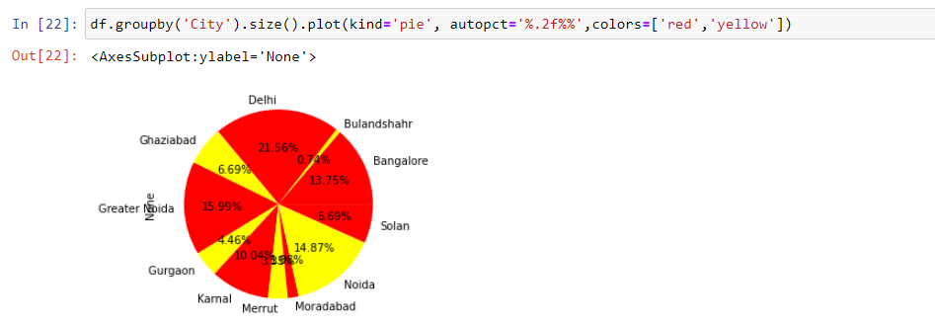
DATA VISUALIZATION

Slide 14

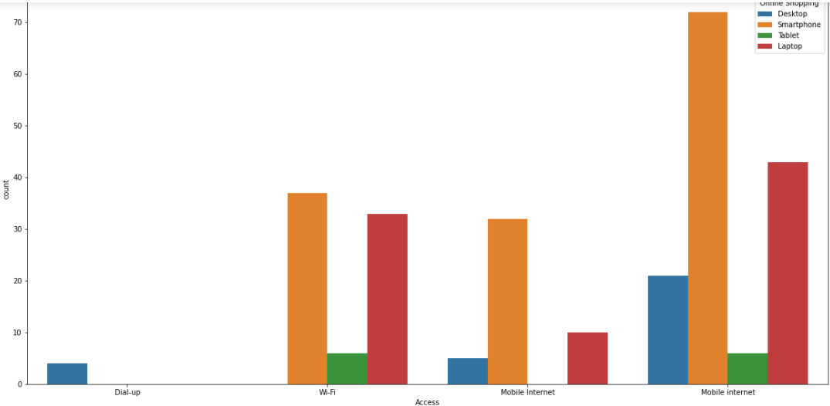
DATA VISUALIZATION

Slide 15

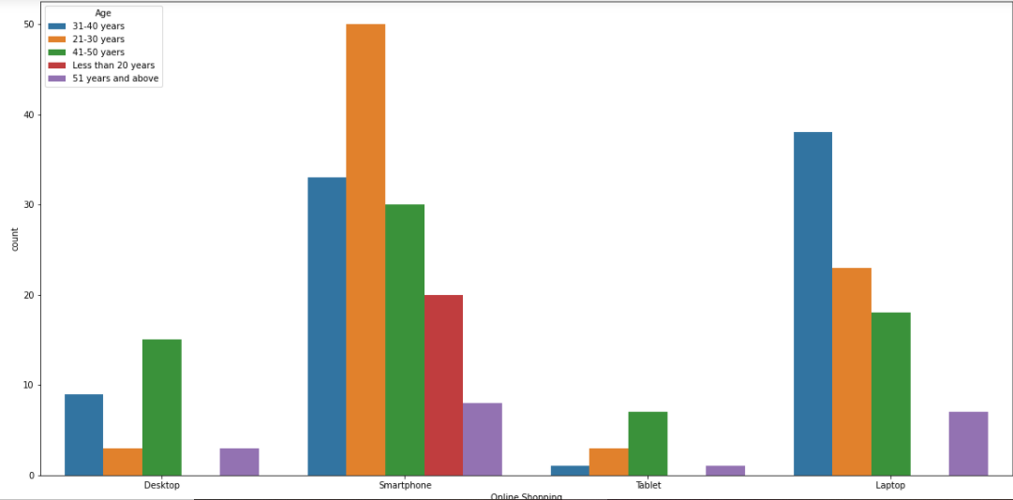
DATA VISUALIZATION

Slide 16

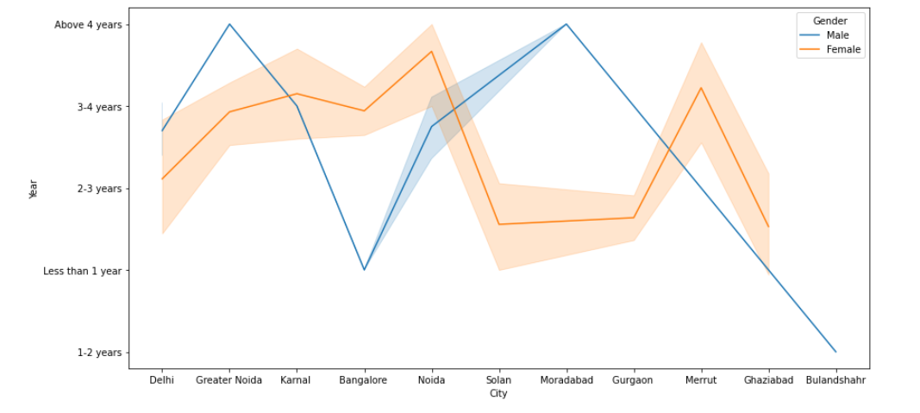
DATA VISUALIZATION

Slide 17
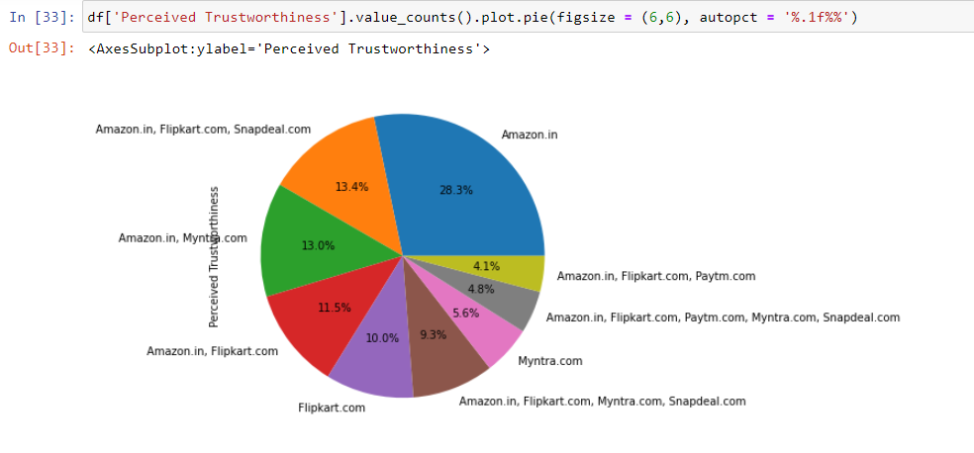
DATA VISUALIZATION

Slide 18
Assumption
1)Max shopping is done by the age group of 31-40 years and Least is done by 50 yrs and above.
2)Also we saw that in Gender:Max shopping is done by Females compare to the Males.
3)We can also observe that Delhi is very famous in shopping its in high perioty and Bulandshahr is in least.
=>So,here we can give a conclusion that Ladies(Female) in the age group of 31-40years do the maximum
shopping in Delhi region.
4) )Here we can see that online shopping is min done with Dial-up only using destop it is done.
5)Here we can also observe that Mobile Internet plot is very highly used. People use smartphone for doing shopping.
6)Here we can see more than Wifi, Mobile internet is used.

Slide 19
7)Here we can observe that 21-30years of age group do more shopping usinng smart phone
8) And also we can find out using Tablet only age group of 41-50 yrs do shopping.But ratio of 31-40yrs and 50 yrs above is same
in the least cateogry in shopping
Male:-1) Here we can see Male from last 3-4 years are doing more shopping in Delhi, Greater Noida, Banaglore.
2) And it falls in Bulandshahr.
Female:-1) from last 3-4 yrs female shopping is increased in Banglore and Noida.
2)Drasctically it decreased in last 2-3 yrs in Solan city and Gurgaon.
3)Again it is drascticaally increased and than decreased.

Slide 20
CONCLUSION
From this visualization here I can conclude that: Retailors can invest more in as follows:
1)Female do more shopping. So more things related to female can be added
2)People find Amzone more save and worthy for shopping. So, amazon, Flipkart Retailors can use for there products to add more
3)City like Banglore, Delhi, Noida is more used for shopping. So, retailors from this place can thing to start a business it will give plus point to their work.
4)People age group of 31-40yrs its male or female they do more shopping. So, it can be keep in mind and Retailors can thing allot of ways to in hence there business
5) Customers satisfaction play a major role in retention, A company should first understand what customers expect while purchasing online (e-commerce) and build a better buying experience which will in turn retain the customer. An unforgettable experience is what drivers customers to buy again and again.

Slide 21
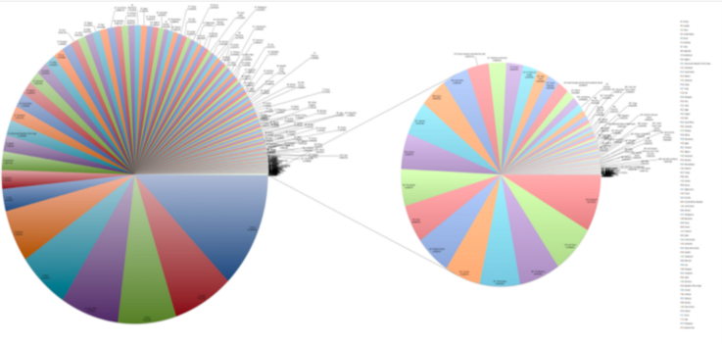
Thank You!
For Watching

